Slide 1
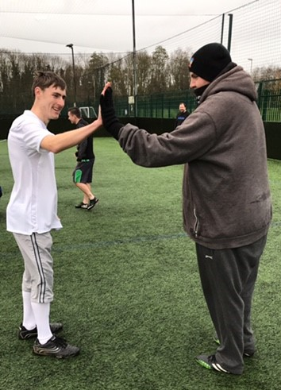
Working in partnership to deliver positive health outcomes
All to Play For - a football programme for men with mental health issues in Norwich and Great Yarmouth
Collaborative working partnership - Active Norfolk - Premier Foundation - Norfolk & Suffolk NHS Foundation Trust
£20K funding secured from Norwich CCG to deliver additional programmes in Norwich after demonstrating positive health outcomes for local residents
Supporting men to improve their mental health Aim to increase uptake and awareness of mental health and other support services available to them, whilst increasing activity levels
Over 80 men have taken part to date:
65% reported low mental wellbeing scores at baseline
2/3 of participants aren’t receiving direct mental health support
54% of attendees were referred from a friend,
“My mental state is more positive due to this group, it gives me something to look forward to and gives me a sense of purpose.”
Notes:
Identify need to have partnerships from the start to make projects sustainable

