Slide 1
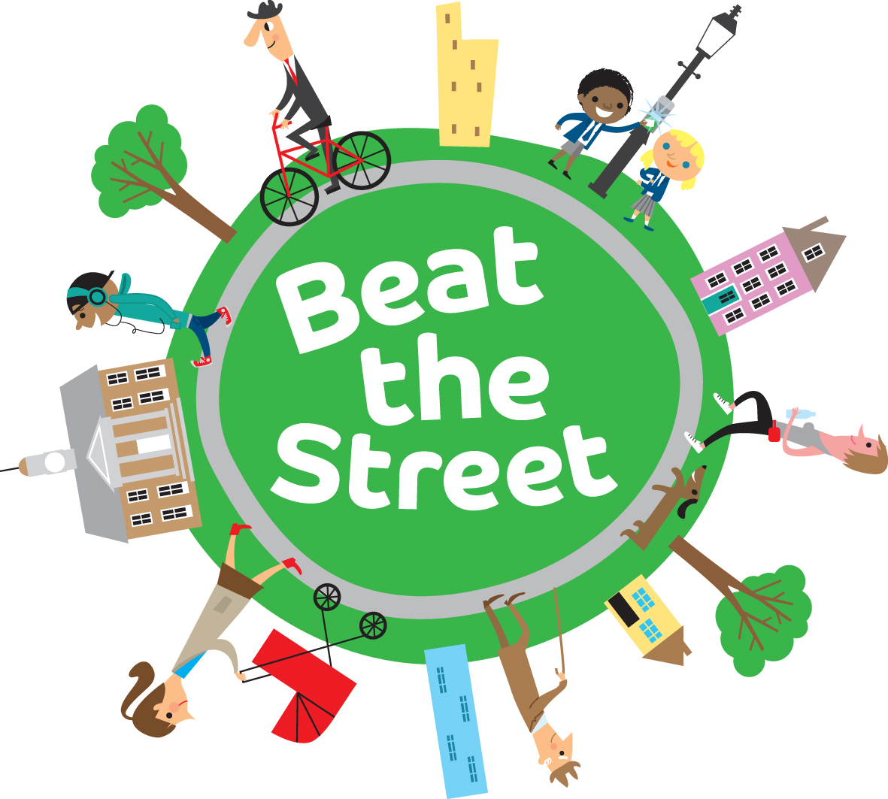
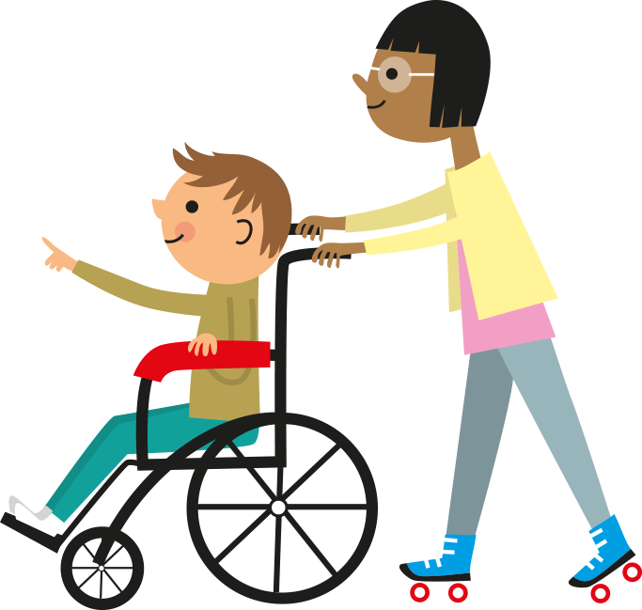
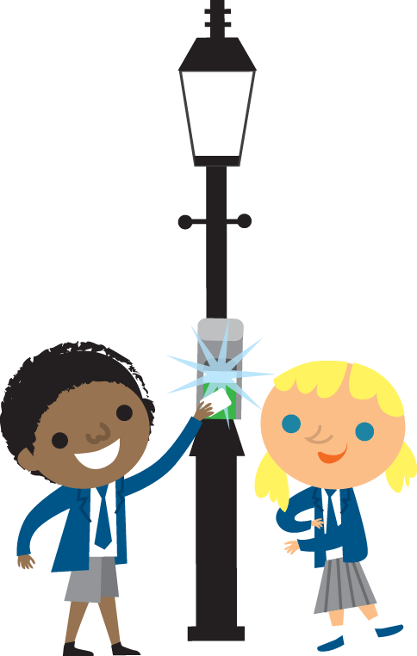
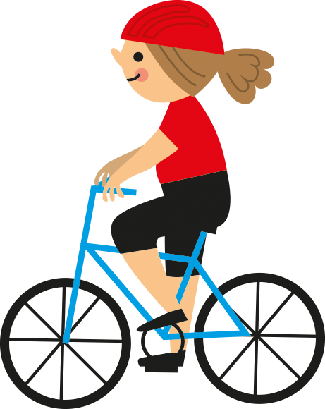
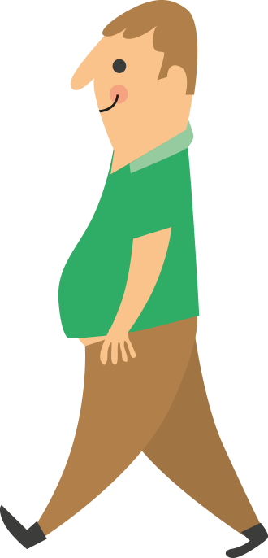
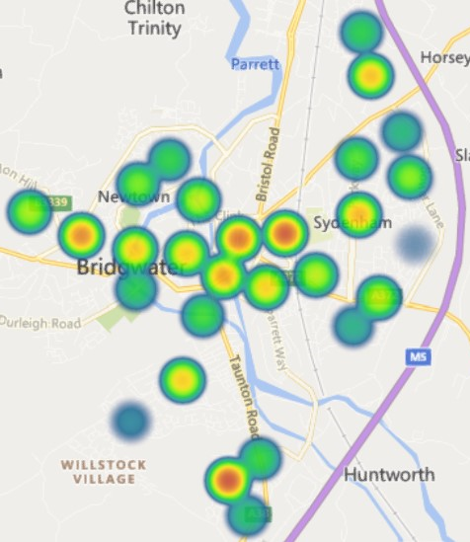
Beat the Street Bridgwater
Beat the Street is an evidence-based population level, behaviour-change programme that creates a social norm around being active. It connects people to each other and their environment and addresses health inequalities through small changes to daily behaviour. In Bridgwater it brought partners together to deliver shared objectives on improving people’s health and wellbeing, active travel and the environment and catalysed local strategies. Sustainability is in the behaviour change of participants – enabling them to take control of their health.
Headline Findings
3654
45,737
66%
63%
Total players
Miles were travelled
Of inactive adults became active
Of less active children became active
Demographics
Movement Data
Age: 48% of players were adults (using cards) and 52% were children (using fobs).
Gender: 75% of adults were female.
Ethnicity: 96% were of white ethnic background.
Long-term Medical Condition: 13% had a long-term medical condition.
Disability: 4% had a disability.
Level of Deprivation: 37% were living in the 20% most deprived areas, whereas 64% were living in the 40% most deprived areas.
Throughout the 4- week game, 149,945 taps were recorded on Beat Boxes and a 45,737 miles were travelled – an average of 11 miles per person.
The heatmap (right) shows there was high engagement with Beat Boxes across Bridgwater.
Qualitative Feedback from Children
265 children provided qualitative feedback post-game. These responses suggested children had become more physically active and more connected to each other and the local area.
“During this nasty virus it was nice to get out and go for a walk in places/areas of Bridgwater we wouldn’t have normally walked” – Girl, under 11
“Beat the street help me to want to walk more and to see more of my town which was fun. And my mum said it help me fall asleep quicker at night, so she was happier” – Female, under 11
“I visited other parts of the town. I searched for the signs. I was more active on a daily basis. I walked and ran.” – Boy, under 11
“It helped me because it got me and my family out and about more often. Also, I spent more time outside than inside.” –
Boy, under 11

Slide 2
Beat the Street Bridgwater
Adult Behaviour Change
The proportion of adults reporting being inactive decreased from 25% to 17%, whereas the proportion reporting undertaking 150+mins per week increased from 64% to 71% (based on 239 adults)
Child Behaviour Change
The proportion of children reporting being less active (<30 mins per day) decreased from 26% to 20%, whereas the proportion reporting undertaking 60+mins per day increased from 42% to 57% (based on 316 children)
Qualitative Feedback from Adults
286 adults provided qualitative feedback post-game. Open question feedback from adults suggested the game brought families together and increased physical activity, especially walking.
“My son was really enthusiastic about this and on several occasions, we got out and about to play regardless of rain or shine! It made us both feel much happier and enjoyed each other’s company!” – Female, aged 30-39
“I took the long way to work just to get extra boxes & I went out with my daughter at the weekend which was a lovely excuse to get out and spend more time together” – Female, aged 40-49
“I have been going out for longer and more regularly. I cycled my bike for the first time in a long time.” –
Male, aged 30-39
“It brought the whole family together. It didn't feel like exercise as it was so much fun!” – Female, aged 30-39

